Slide 1
Bazele inteligenței artificiale
Laborator – Grigore Ionuț

Slide 2
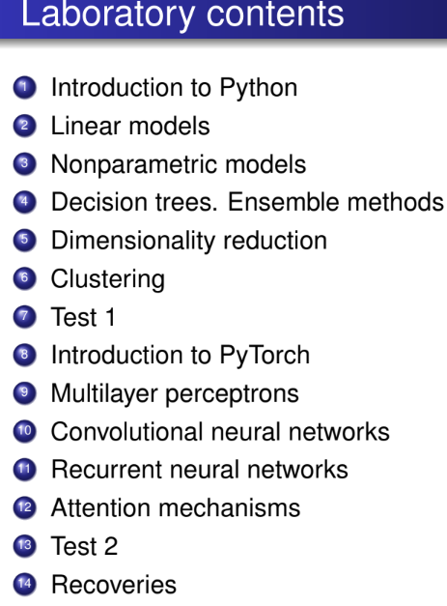

today’s lab

Slide 3
Content
Decision trees
Voting
Bagging and pasting
Random forests
Boosting

Slide 4
1) Decision trees

Slide 5
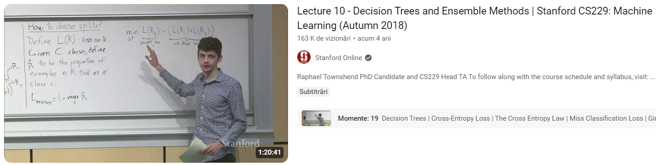
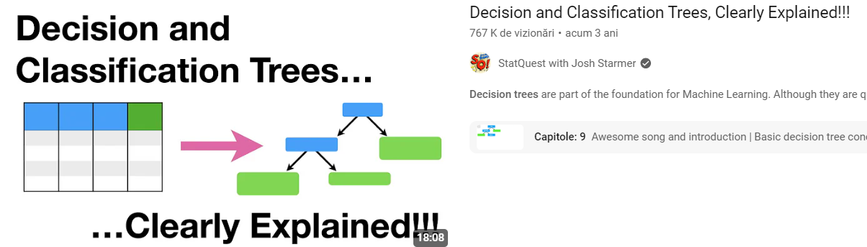

Slide 6
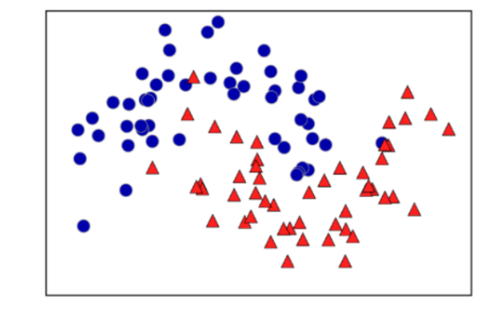
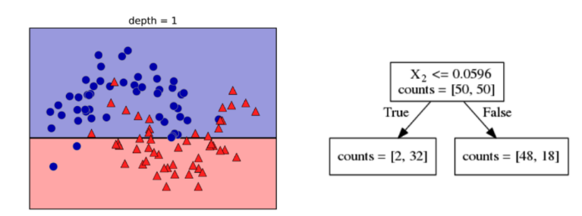
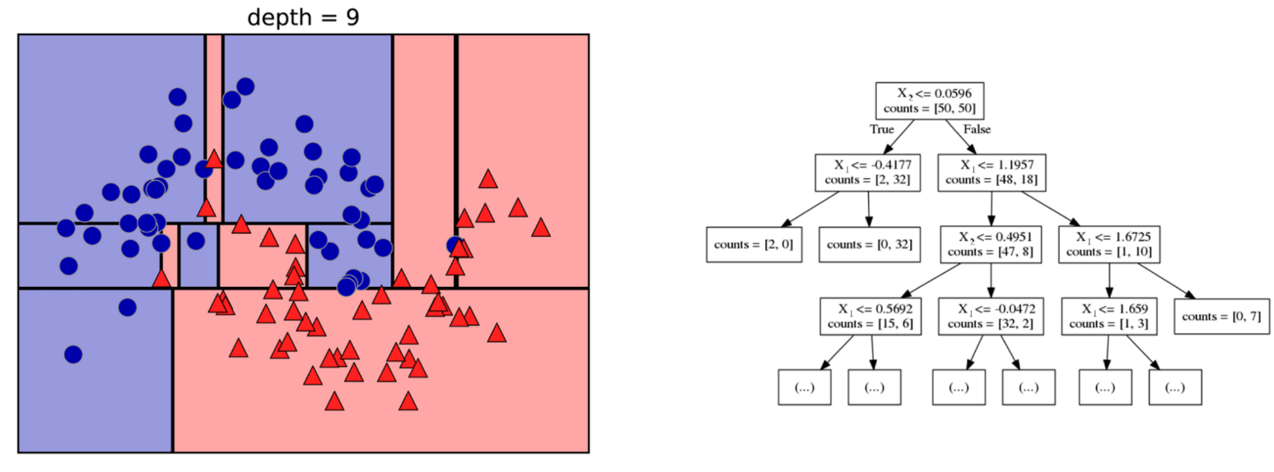
X₂
X₂
X₁
X₁
moons dataset
X₂
X₂
X₁
X₁

Slide 7
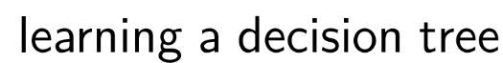
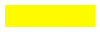


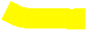
X₂
X₁
a prediction on a new data point is made by checking which region of the partition of the feature space the point lies in and then:
predicting the majority target (or the single target in the case of pure leaves) in that region in the case of classification
predicting the mean target of the training points in the case of regression

Slide 8


Example:
if after traversing the tree from the root to the leaves the yellow test point is here, then:
classification the test point will become blue
regression the test point will be the mean of the 2 blue points
if after traversing the tree from the root to the leaves the yellow test point is here, then:
classification the test point will become red
regression the test point will be the mean of the 33 red points

Slide 9
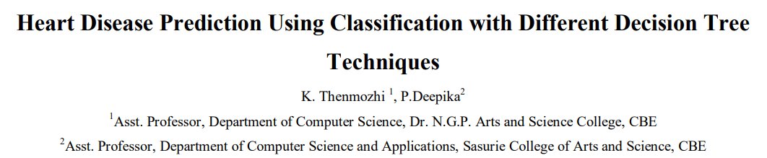
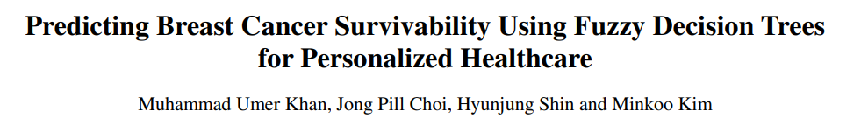
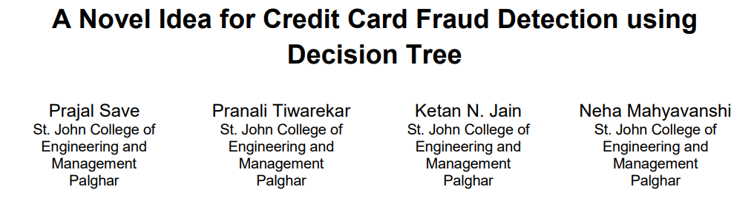
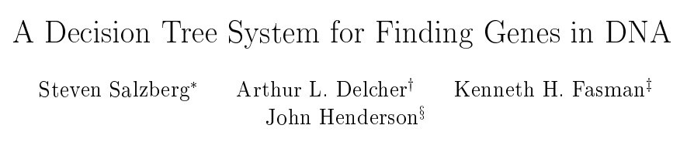
Some real-world use case examples…

Slide 10
Code part

Slide 11
Classification

Slide 12
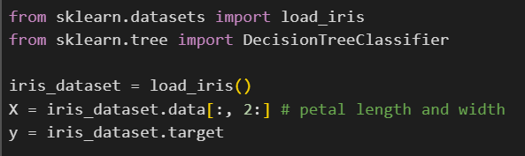
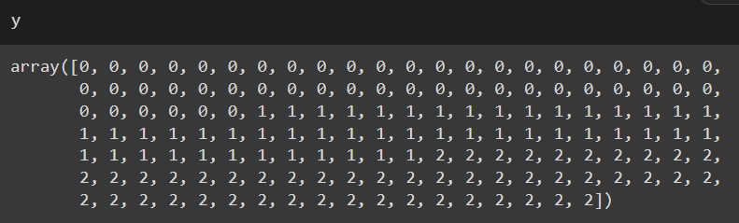
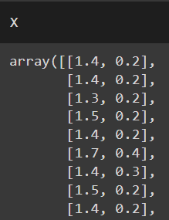
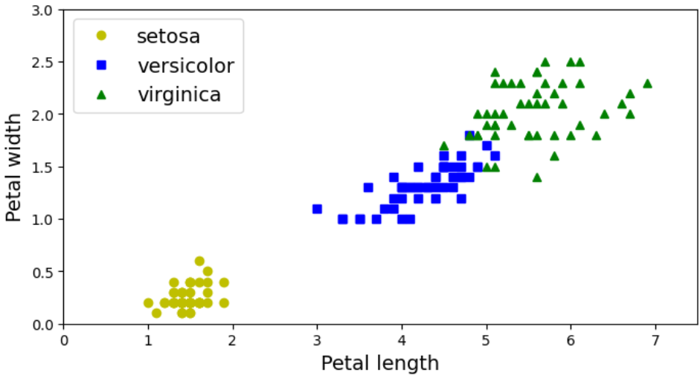

Slide 13
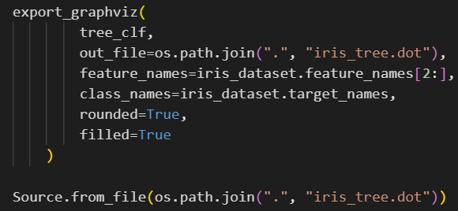
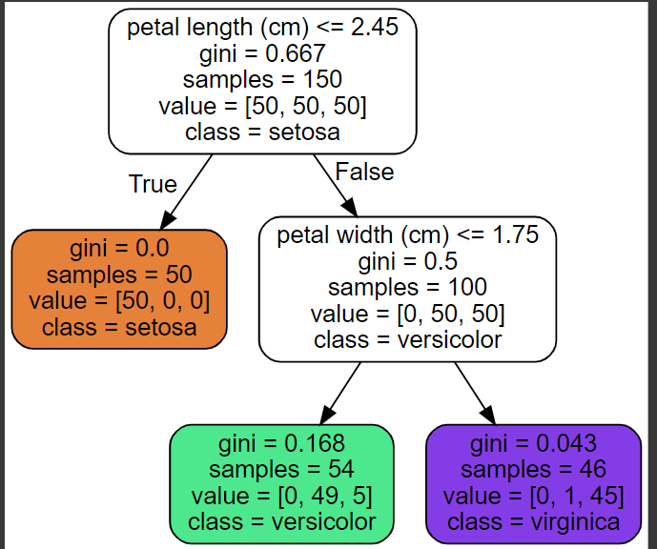

gini attribute measure the impurity of the node: gini = 0 means a pure node

Slide 14
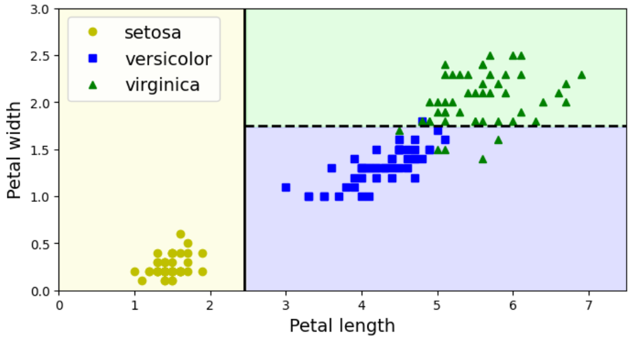
plot_decision_boundary() function already done in lab
1.75
2.45

Slide 15
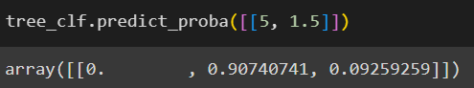
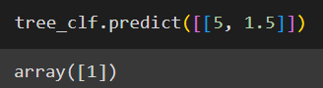
Prediction:
iris versicolor (class 1) because it has the highest probability.

Slide 16
Regression

Slide 17
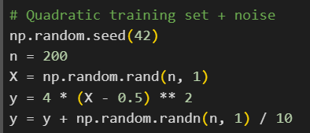
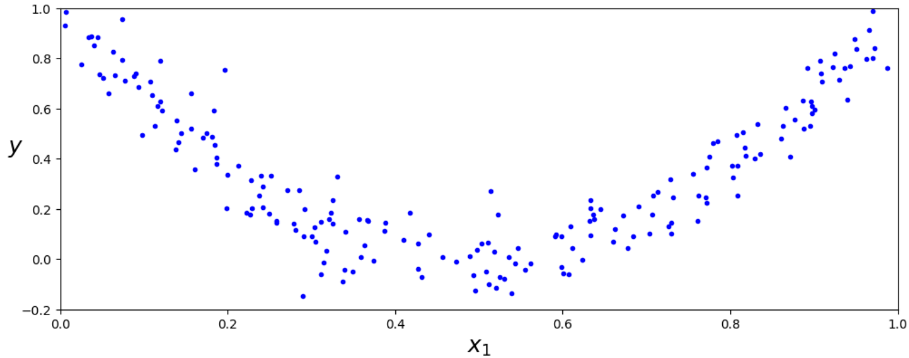

Slide 18
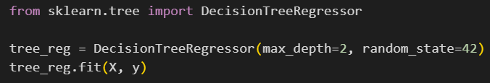
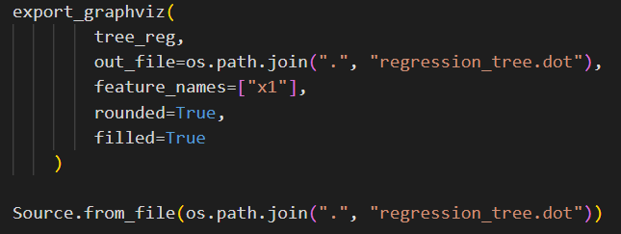
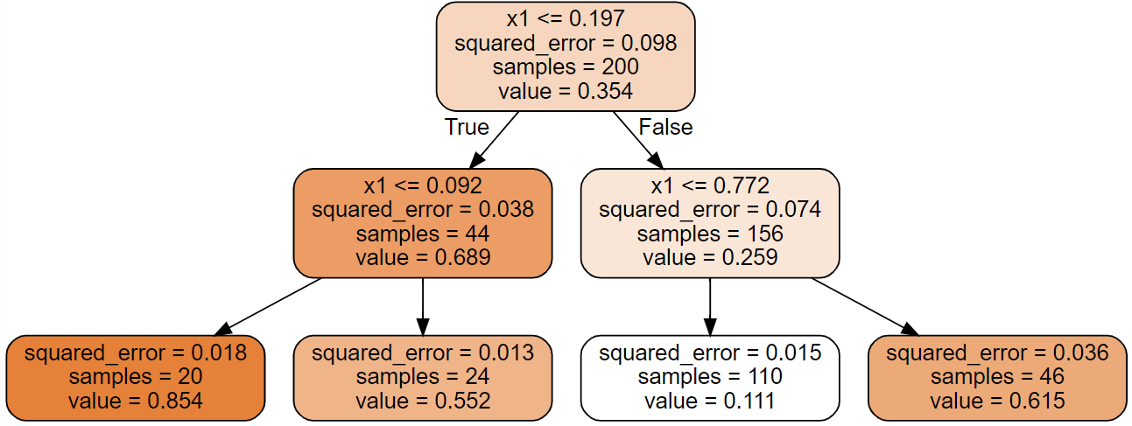
very similar to the classification tree we built earlier
the main difference is that, instead of predicting a class in each node, it predicts a value
for example, suppose we want to make a prediction for a new instance with x₁=0.6
we traverse the tree starting at the root, and we eventually reach the leaf node that predicts value=0.111
this prediction is the average target value
of the 110 training instances associated with
this leaf node

Slide 19
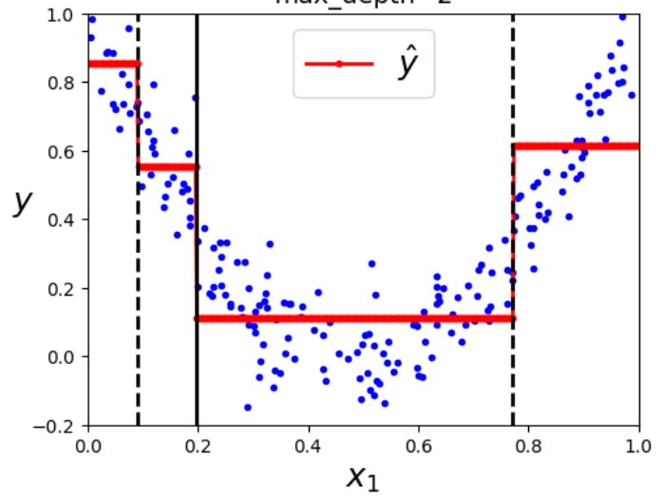


plot_regression_predictions() function already done in lab
0.854
0.092
0.772

Slide 20
2) Voting

Slide 21

if we aggregate the predictions of a group of predictors (classifiers or regressors), we will often get better predictions than with the best individual predictor
a group of predictors is called ensemble
suppose we have trained a few classifiers, each one achieving about 80% accuracy
a simple way to create an even better classifier (maybe 85% accuracy) is to aggregate the predictions of each classifier and predict the class that gets the most votes

Slide 22
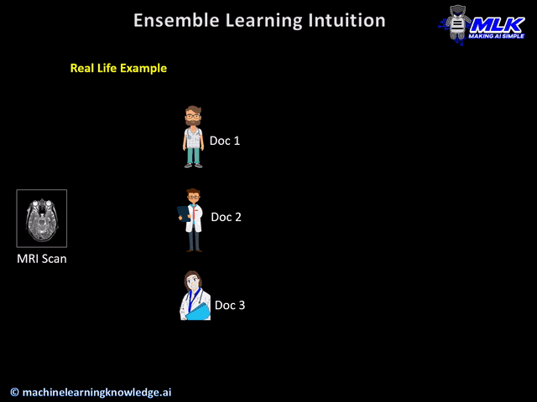


Slide 23
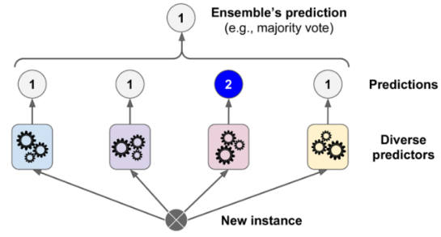
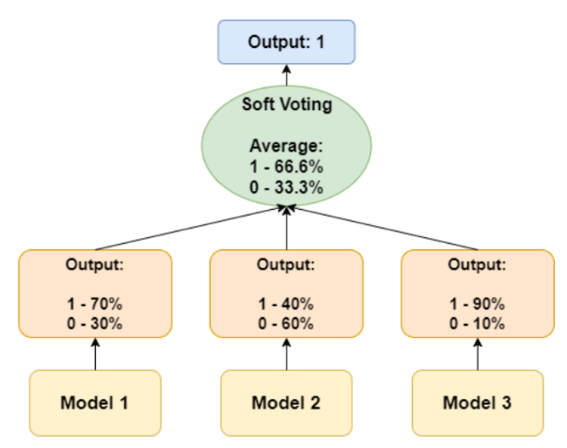
hard voting classifier aggregate the predictions of each classifier and predict the class that gets the most votes:
soft voting classifier if all classifiers are able to estimate class probabilities and we predict the class with the highest class probability averaged over all the individual classifiers:

Slide 24
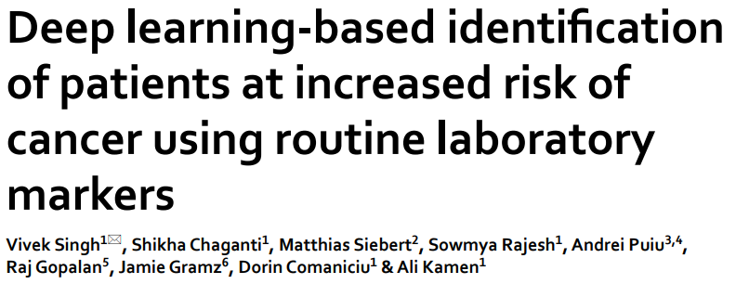
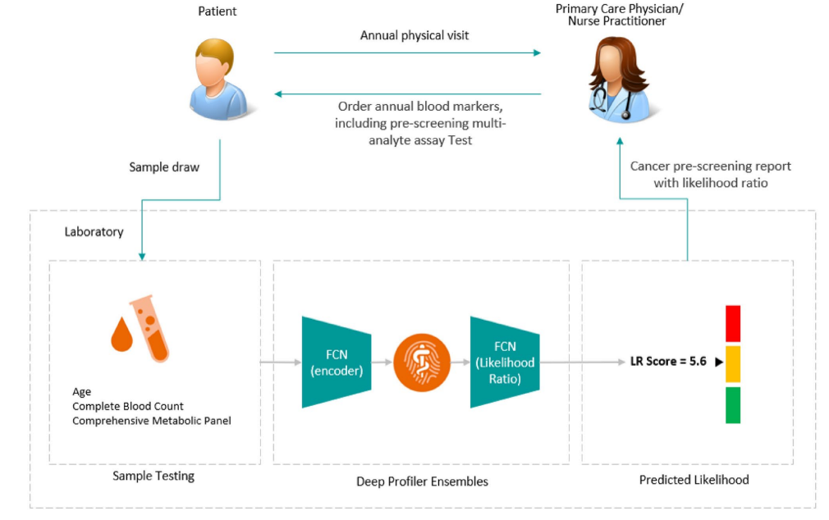
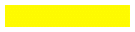
Example from Previous Work: Ensemble Model for Cancer Risk Prediction
Patient gives a blood sample → sent to the lab.
AI model (ensemble of neural networks) analyzes the results.
Each model (called a Deep Profiler) learns different medical patterns.
Their outputs are combined into one “likelihood ratio” score.
The score helps doctors decide if further testing is needed.

Slide 25
Code part

Slide 26
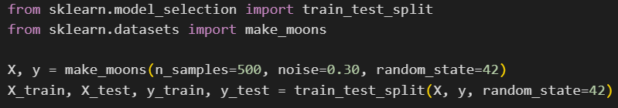
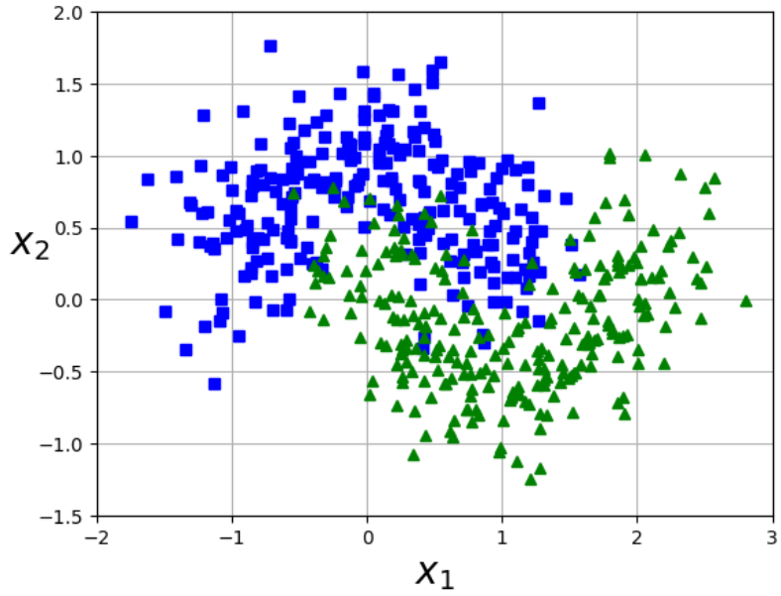
plot_dataset() function from lab 3 ☺

Slide 27
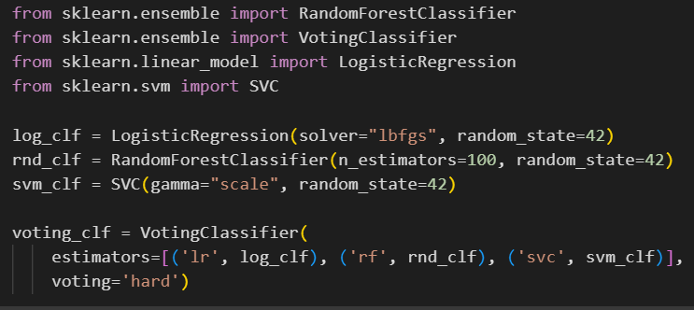
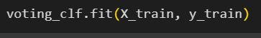
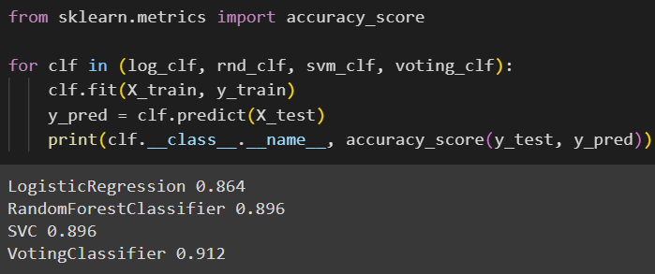

Hard voting

Slide 28
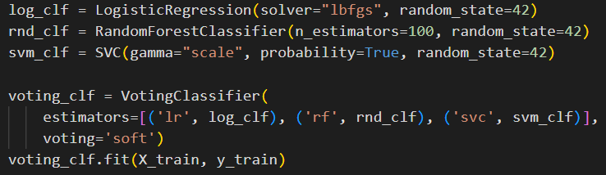
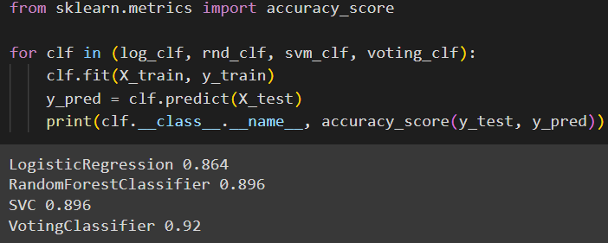

Soft voting

Slide 29
3) Bagging and pasting

Slide 30

use the same training algorithm for every model/predictor but train them on different random subsets of the training set
when sampling is performed with replacement bagging
when sampling is performed without replacement pasting
once all models/predictors are trained, the ensemble can make a prediction for a new instance by simply aggregating the predictions of all models/predictors
often called bootstrap

Slide 31
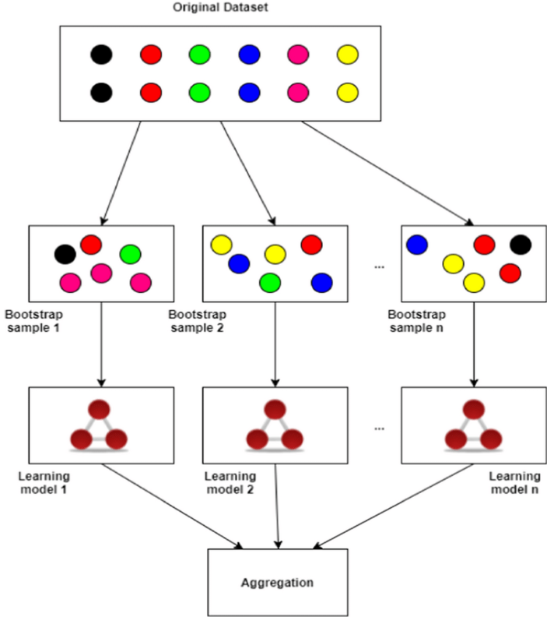
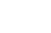
training set
training set
bagging
pasting
subset 1
subset 2
subset n
subset 1
subset 2
subset n
model/
predictor 1
model/
predictor 2
model/
predictor n
model/
predictor 1
model/
predictor 2
model/
predictor n
aggregation
aggregation
suppose you have a dataset with 12 points
for each model, you want to draw 6 random samples from these 12 points.
if you're sampling with replacement, then for each model:
randomly select a data point from the 12 data points.
record that selection, but then put that data point back into the pool of 12 data points, so it can be selected again.
repeat this process 6 times.
suppose you have a dataset with 12 points
for each model, you want to draw 6 random samples from these 12 points.
if you're sampling without replacement, then for each model:
randomly select a data point from the 12 data points.
record that selection, but do not put that data point back
into the pool of 12 data points, so it can’t be selected again.
3.repeat this process 6 times.

Slide 32
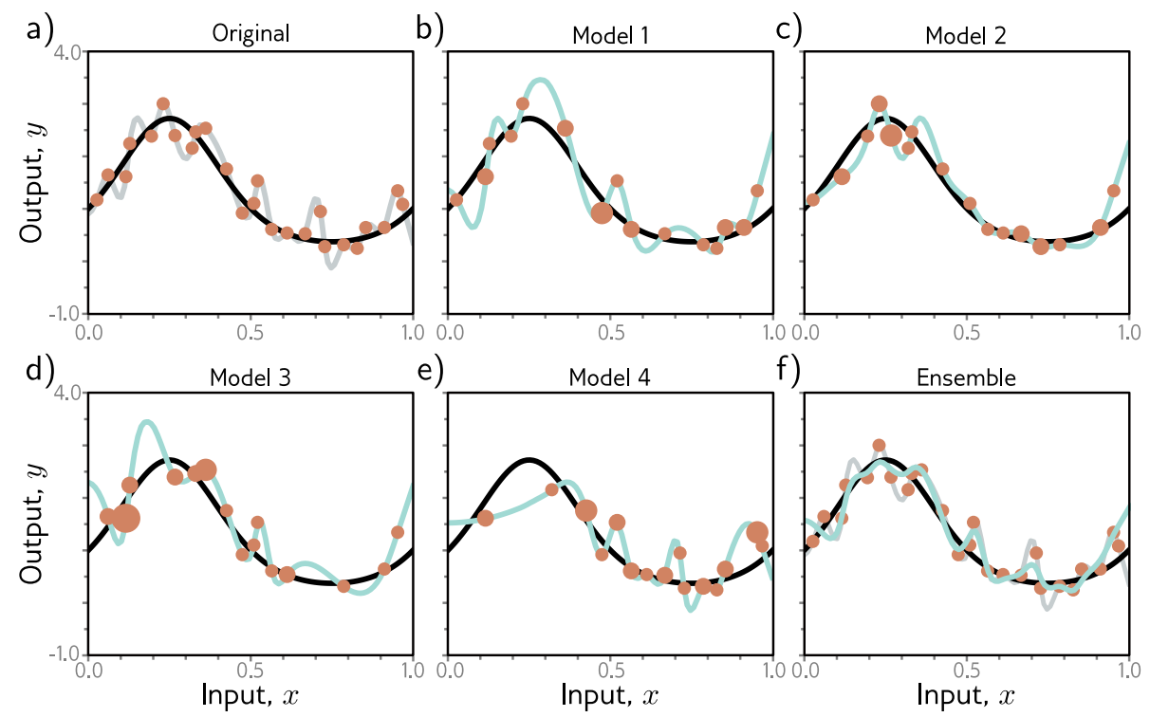


No more wiggle wiggle ☺
Averaging multiple “wiggly” models can reduce overfitting and variance, leading to smoother and more stable predictions!

Slide 33
Code part

Slide 34
plot_dataset() function from lab 3 ☺

Slide 35
Bagging

Slide 36
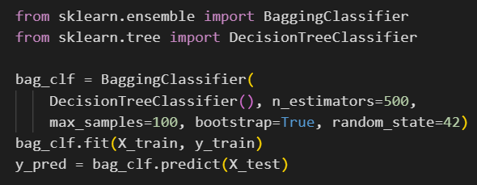
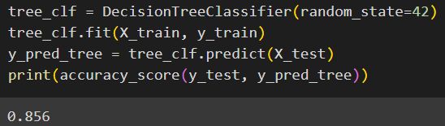
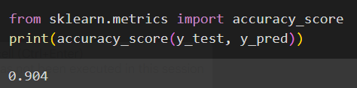

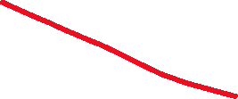
use an ensemble of 500 decision tree
each decision tree is trained on 100 training instances
the 100 training instances are randomly sampled from the training set with replacement bagging
accuracy for a single decision tree classifier:
accuracy the bagging classifier:

Slide 37
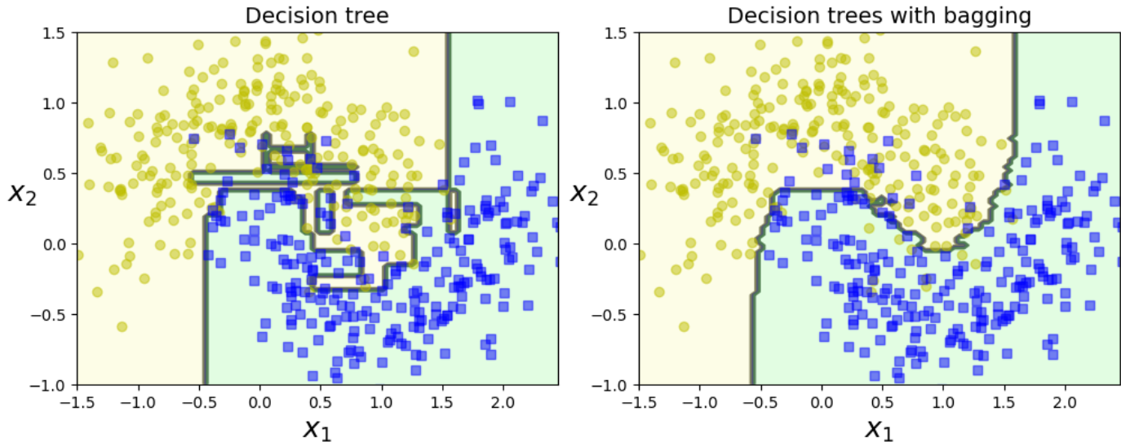
plot_decision_boundary()
function already done in lab

Slide 38
Pasting

Slide 39
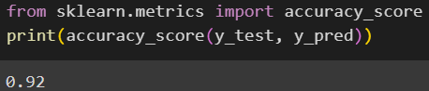


use an ensemble of 500 decision tree
each decision tree is trained on 100 training instances
the 100 training instances are randomly sampled from the training set without replacement pasting
accuracy for a single decision tree classifier:
accuracy the pasting classifier:

Slide 40

plot_decision_boundary()
function already done in lab

Slide 41
4) Random forests

Slide 42


Slide 43

an ensemble of decision trees, generally trained via the bagging method (or sometimes pasting), typically with maximum number of samples set to the size of the training set

Slide 44
Code part

Slide 45






don’t worry about them ☺

Slide 46
5) Boosting

Slide 47



Slide 48
general idea of boosting methods: train models/predictors sequentially, each trying to correct its predecessor
AdaBoost new models/predictors pay more attention to the training instances that the predecessor underfitted
gradient boosting new models/predictors try to fit to the residual errors made by the previous predictor

Slide 49



Slide 50

AdaBoost steps:
first train a base classifier (such as a decision tree) and use it to make predictions on the training set
increase the relative weights of misclassified training instances
train a second classifier using the updated weights, use it to make predictions on the training set, update the instance weights and so on

Slide 51


1)
The weights for all samples start at 1/N (where N is the total number of samples, 4 in this case).

Slide 52



2)

Slide 53

3, 4)

Slide 54


5)

Slide 55


6, 7)

Slide 56



8, 9)

Slide 57
Scopul: Să îmbunătățim un clasificator simplu (ex: un arbore mic de decizie) făcându-l să învețe mai mult din greșeli la fiecare pas.
Ideea de bază: În loc să dăm aceeași importanță tuturor exemplelor, AdaBoost mărește ponderea celor clasificate greșit — ca următorul model să fie mai atent la ele.
Pașii principali:
🔹 Antrenăm primul clasificator pe toate exemplele (cu ponderi egale).
🔹 Vedem ce exemple a greșit și le creștem ponderea.
🔹 Antrenăm un al doilea clasificator — acesta acordă mai multă atenție exemplelor dificile.
🔹 Repetăm procesul (ajustăm ponderi, adăugăm noi modele).
🔹 Predicția finală = combinația ponderată a tuturor clasificatorilor.
De ce funcționează: Fiecare model nou se concentrează pe erorile anterioare, transformând o serie de clasificatori slabi într-un model puternic și robust.
Pe scurt: AdaBoost = învățare din greșeli prin reponderarea exemplelor dificile.

Slide 58
Gradient Boosting steps:
consider a regression problem where we use decision trees as predictors
train a first DecisionTreeRegressor on the training set
train a second DecisionTreeRegressor on the residual errors made by the first one
train a third DecisionTreeRegressor on the residual errors made by the second one
now we can make predictions on a new instance simply by adding up the predictions of all the 3 trees

Slide 59





^
^
^
^
-1
original training set

Slide 60

Scopul: Să combinăm mai mulți arbori de decizie simpli (slabi) astfel încât fiecare să corecteze greșelile celui anterior.
Ideea de bază: În loc să antrenăm un singur model mare, antrenăm o serie de arbori care învață reziduurile (adică erorile rămase) de la pașii precedenți.
Pașii principali:
🔹 Antrenăm primul arbore pe datele originale (X, y).
🔹 Calculăm reziduurile = valoarea reală – predicția arborelui.
🔹 Antrenăm al doilea arbore să prezică aceste reziduuri.
🔹 Calculăm din nou reziduurile (ce nu a reușit să repare al doilea arbore).
🔹 Repetăm procesul pentru mai mulți arbori.
🔹 Predicția finală = suma tuturor predicțiilor (fiecare arbore contribuie puțin).
De ce funcționează: Fiecare arbore învață unde a greșit sistemul anterior → modelul devine tot mai precis la fiecare iterație.
Pe scurt: Gradient Boosting = învățare treptată din erori + combinarea arborilor pentru o predicție finală mai bună.

Slide 61
Code part

Slide 62
AdaBoost

Slide 63
plot_dataset() function from lab 3 ☺

Slide 64


plot_decision_boundary()
function already done in lab

Slide 65
Gradient Boosting

Slide 66




Slide 67




train a first DecisionTreeRegressor on the training set
1)
train a second DecisionTreeRegressor on the residual errors made by the first one
2)
train a third DecisionTreeRegressor on the residual errors made by the second one
3)
now we can make predictions on a new instance simply by adding up the predictions of all the 3 trees
4)

Slide 68


…or in a simpler way…
plot_predictions()
function already done in lab

Slide 69

Decision trees: learn by asking if/else questions to split data into pure regions.
Classification: predict the majority class in each leaf.
Regression: predict the mean value in each leaf.
Voting (Ensemble of Models): combine multiple classifiers/regressors for better accuracy.
Hard Voting: majority vote of class predictions.
Soft Voting: average class probabilities and choose the highest.
Bagging and pasting: train same model on random subsets of the data:
Bagging: with replacement (bootstrap sampling).
Pasting: without replacement.

Slide 70
Random Forests: Ensemble of Decision Trees trained via bagging.
Boosting: train models sequentially, each correcting previous errors.
AdaBoost: focus more on misclassified samples.
Gradient Boosting: fit new models to residual errors.

Slide 71
Exercises

Slide 72


Slide 73



Solutions

Slide 74



Slide 75



Slide 76


NOTE: this is how you can import and use digits dataset !

Slide 77



OPTIONAL: plotting some examples to understand the data you use ☺

Slide 78



Slide 79




Slide 80


Slide 81



Slide 82
Thank you !

